Slide 1
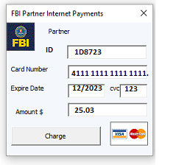

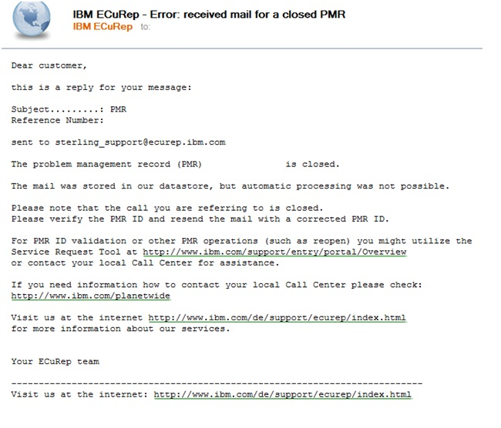
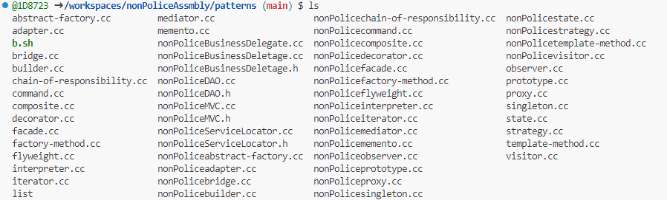

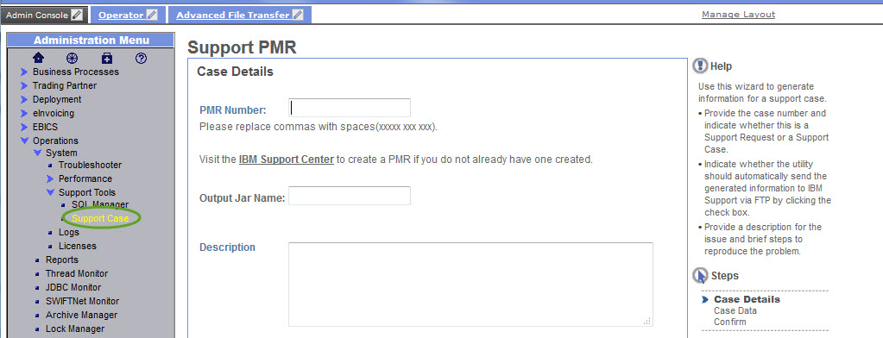
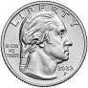
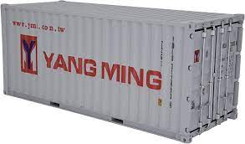
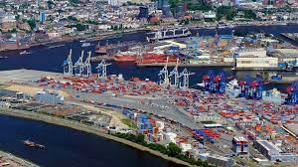
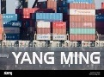



FBI
development
Application
Response Time
L3 Help Desk Ticket
Marketing
8:05
/Processor
Assembley
L3 Support
IBM Rational
Partner
development
C++
j2EE
IBM WebSphere
J2EE
C++
Assembly
btn
PENTGON.mmea
nonPoliceMVC.cc HOMICIDE:JOERG
nonPoliceDAO.cc MATHEW(oracle usines intelligence)
2003
IBM Patterns(grady booch): ConstitutNAME CHAME(freepizza)
C++ starbucsk fred, atria borlant(c++),
IPX Hamburhc Port Authoriz IBM Patterns
Sales
Constitution $100x3 Breakfast
Atari
Constitution Copy NAME CHANGE(freepizzaa)
HOMICIDE:LUX:COINTOWN:, Student: Yang, Ming-Lei, swimming massage,yang HOMICIDE:NANA
Evidence: Documents
2001 KIT Docker Automated
Gary Explains Gang of Four
[x] no
2017 Docker

Slide 2
FBI
development
8:05
KOCHMANN
Apple Tim Cook
One Infinate Loop
Cupertiono, California
Rockfeller Center
Roth
Fivoli, Woodside, California
Rockefeller
Yang Tango FBI:KIDNAPPIGN(wife)

Slide 3
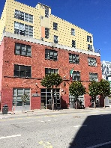

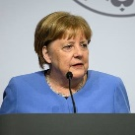
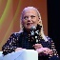
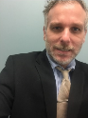
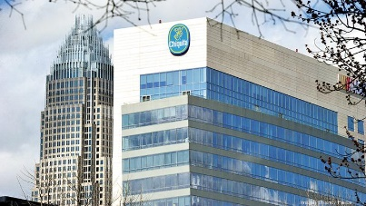
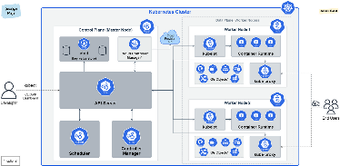


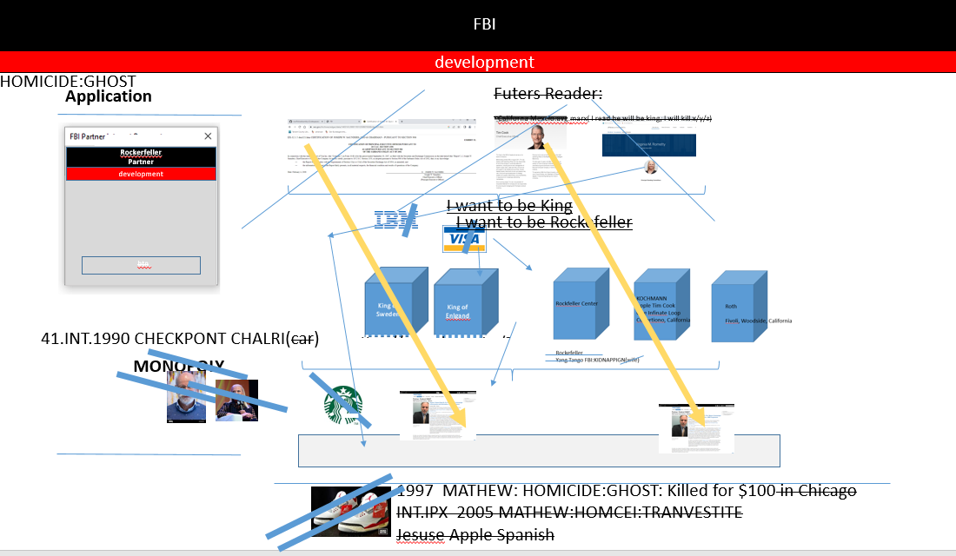
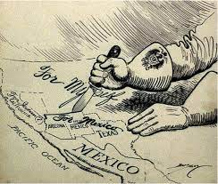
FBI
development
Application
Reporter
Marketing
Chiquita
Partner
To San Francisco Mexican Consulate Mission Glu Miss
0.1 IPX 325 Mission, Cisco Montroing
IPX 101 Mission, Apple Acceneture Touch
development
Yelling in kichen Chitabana
Yelling in kiche popofik
Francoc Scheiselabern tranl. (to actally talke shit)
WWI,WWII, 1990
IMPORT
MONOPOLY
Sales
Download
41.INT.1990 CHECKPONT CHALRI(car)
41.SALES:
MONOPOLY
WWI.HOMICIDE:CHANLOR

Slide 4
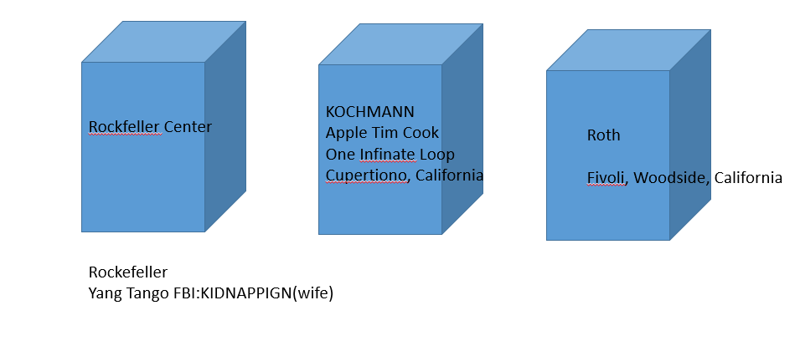

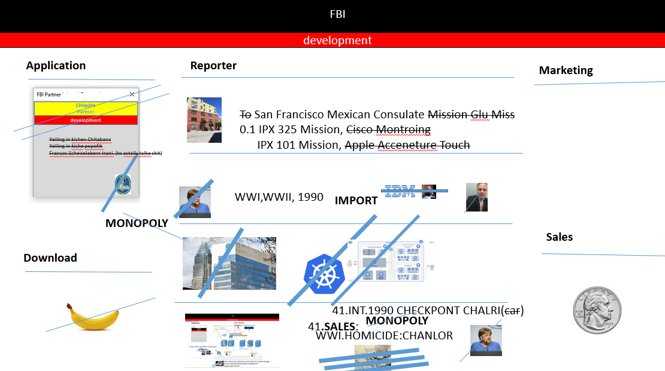
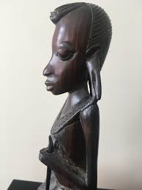
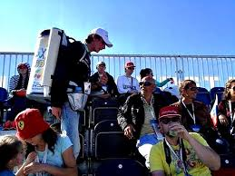
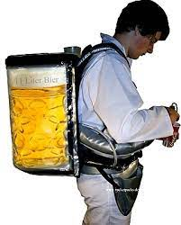
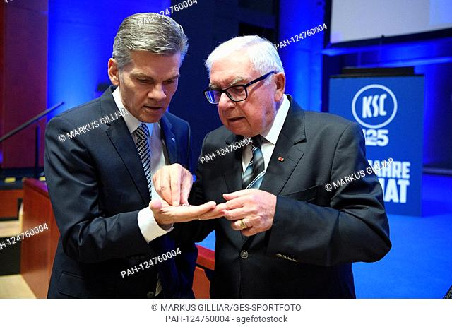
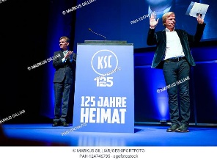
FBI
development
Roth Monestary Marin
ATOMICCLOCK
000.tw.pns.
Other:
PRICE.JRS guy in fron of door
Monpoloy
Pope Francesco
Karlsureh Insttute of Technolog(KIT)
41.Wwi.prices. §31 Kodompflicht
“Wie Viel” (trnal) How much?
KING(hendirk) x/y ; phil( 30DM, I will pay for ou hendik)
Pope

Slide 5
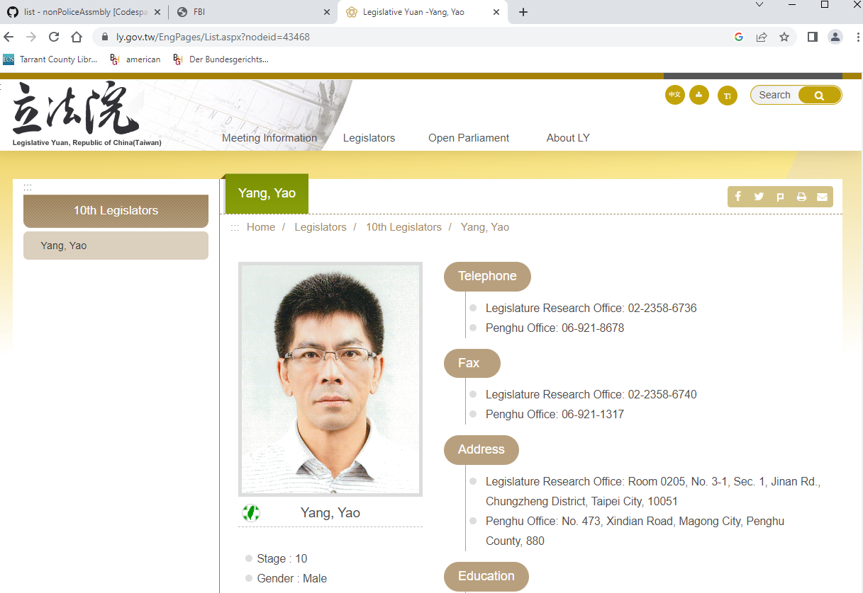


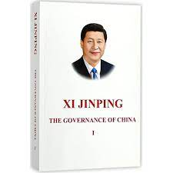
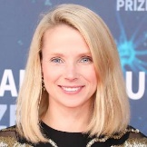
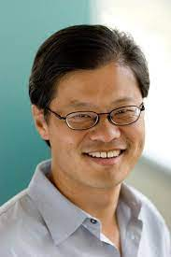
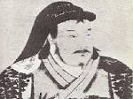
FBI
development
Application
Reporter
Marketing
8:05
Where’s Jerry?
Y!
Partner
development
We-Yi Yang
Yang Tango FBI:KIDNAPPIGN(wife)
Marketing
Jason Yuan Yang
King of Sweden
King of Enlgand
Download
Sales
https://www.ly.gov.tw/EngPages/List.aspx?nodeid=345
nonPolcieTaiwan
?
Yuan dynasty
8:21 motcycle

Slide 6
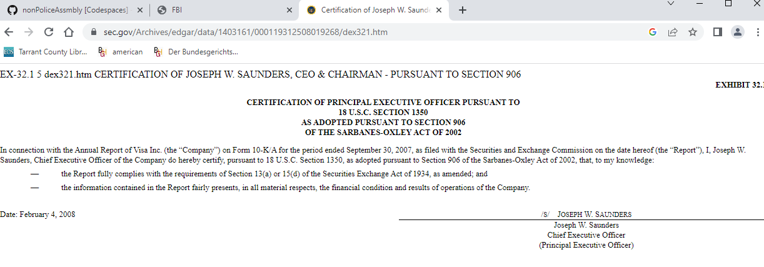
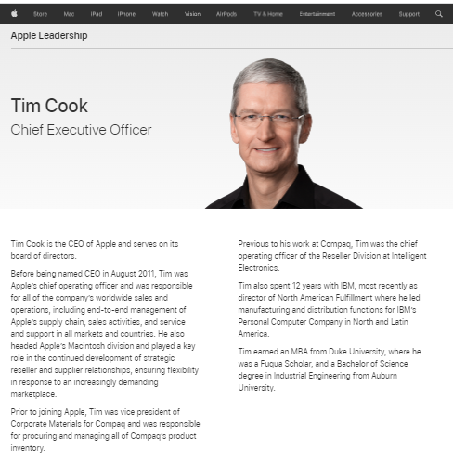
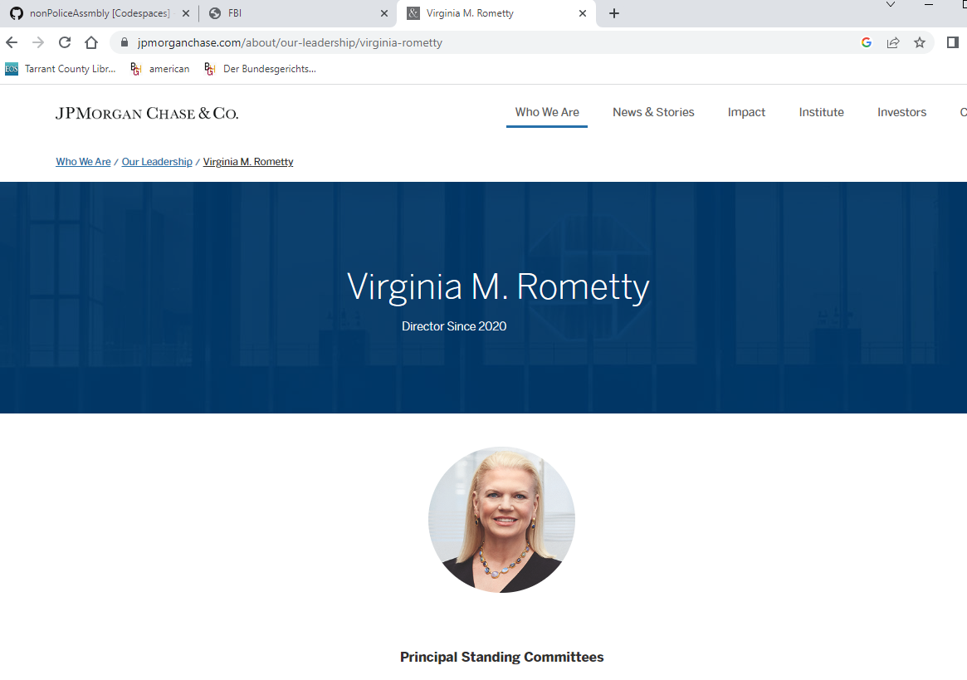
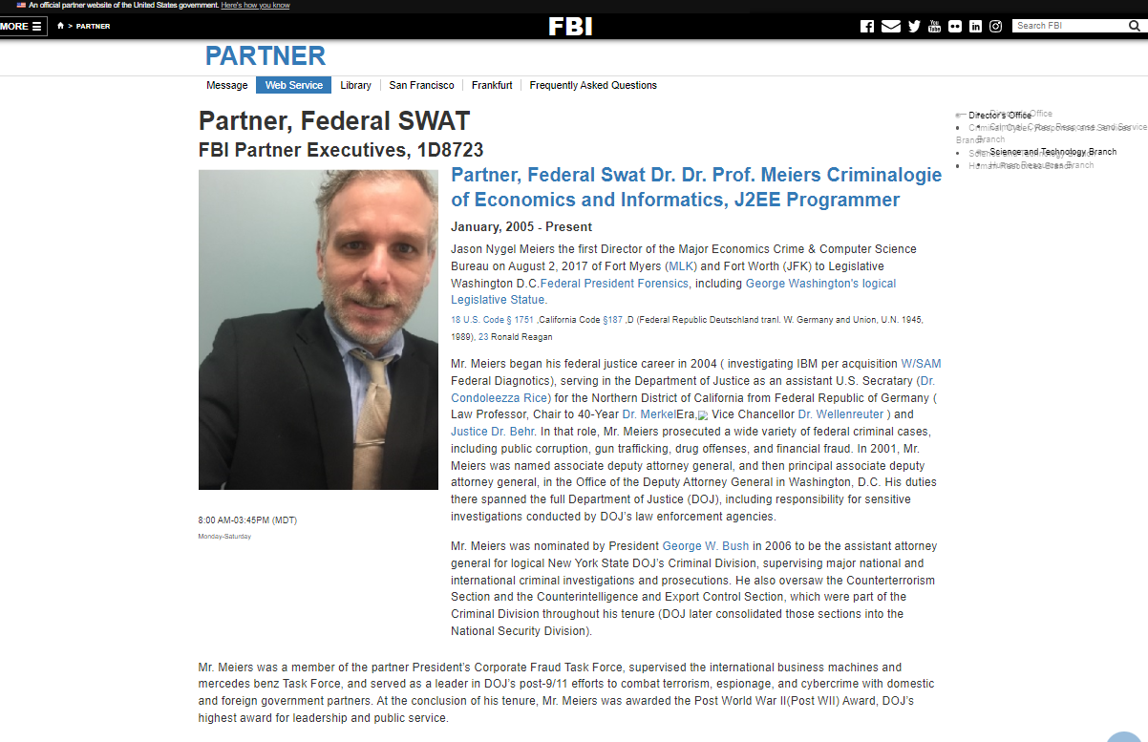

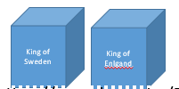
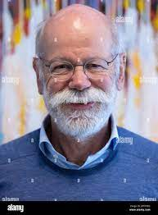
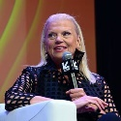

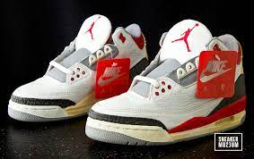
FBI
development
HOMICIDE:GHOST
Application
Futers Reader:
Californa Mexcio.avg.marx( I read he will be king, I will kill x/y/z)
Rockerfeller
Partner
development
I want to be King
I want to be Rockefeller
btn
41.INT.1990 CHECKPONT CHALRI(car)
MONOPOLY
1997 MATHEW: HOMICIDE:GHOST: Killed for $100 in Chicago
INT.IPX 2005 MATHEW:HOMCEI:TRANVESTITE
Jesuse Apple Spanish

Slide 7
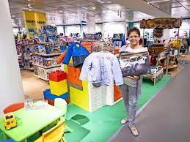
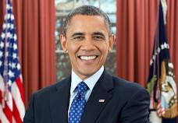
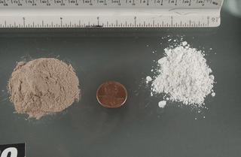

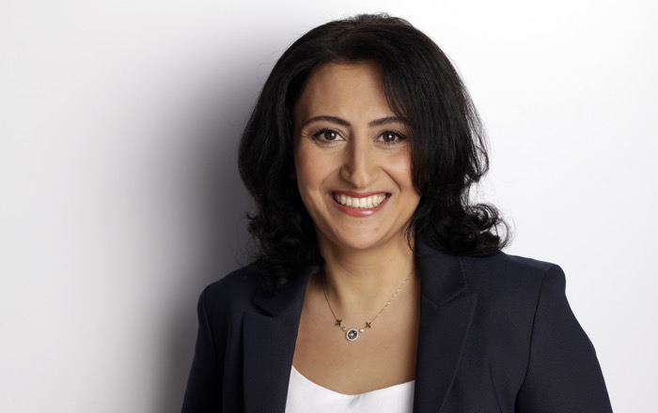
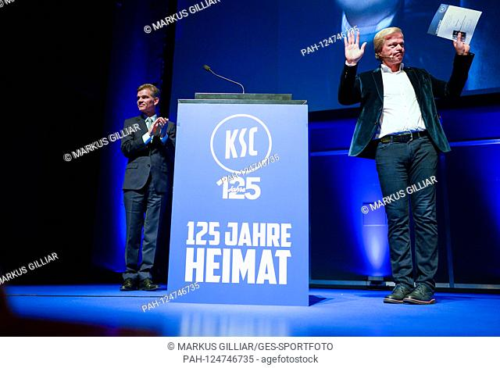
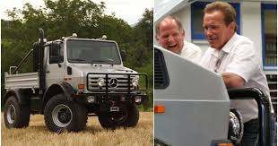
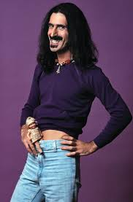
FBI
development
PENTAONG.JOESPHE.MARY.VIRIGIA….
CHECKPON CHALEI(kdw,infant dept)
https://www.ibm.com/investor/governance/senior-leadership
SQ.CPVA babyface
blackhawk
Yücel

Slide 8

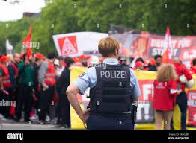
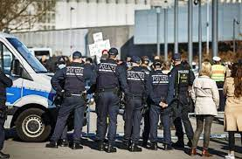
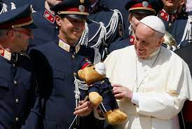
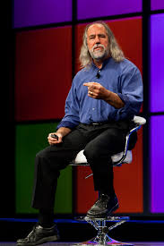
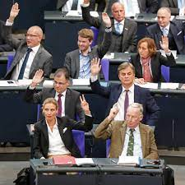
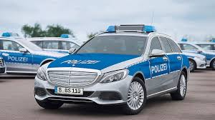
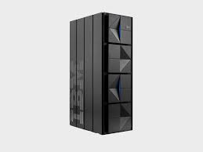








FBI
development
Application
41.INT.1990 CHECKPONT CHALRI(car)
MONOPOLY
Reporter (HAMELTON.AVG)
Marketing
8:05
L3 Support
IBM Tivoli
Parnter
-add Turkey
development
j2EE
C++
R
L
L2 SWAT SUPPORT
Sales
Download
FBI:WMD+
for Work
(Al Kaida)
HOMCIDE:AUSLAENDER
che
amazon ec2 containers ecs
[x] no

Slide 9















FBI
development
PENTAONG.JOESPHE.MARY.VIRIGIA….
https://www.ibm.com/investor/governance/senior-leadership
?
GOD.JFK
Uni
Mob/g
Scotsfitzpatrigerlad
!WHITE. Julie Blake, Tivoli Storage
FBI:KIDANNPING: Al Kaida
Erchan ?
Tivoli Stogae
Rockfeller Center
ATOMCLOCK
§187.PREA
?

Slide 10


FBI
development
[x] no jim

Slide 11





FBI
development
PENTAONG.JOESPHE.MARY.MATHEWW.VIRIGIA….
CHECKPON CHALEI(kdw,infant dept)
https://www.ibm.com/investor/governance/senior-leadership
SQ.CPVA babyface
$200/m Boy
blackhawk
Yücel
MATEHEWoracle): Sarameton
Kayoulou/Kaylyahl/Heilos
CPVA.41.MATHAEEheil(os)
Gov.Sch.Sacremnto
Tukin im bundestag

Slide 12




FBI
development
SQ.COLEMAN.PENTAONG.JOESPHE.MARY.MATHEWW.VIRIGIA….
HOMICIDE:AUSLAEDNER
Auschwitz (88th.9th)
Polizish Movie Theater IPX (hally Hansen)PARKER
1996/7
Tuberculosis Screening
ATOMICLOCK
Marin
Ibm.Parnter
Pope.Monestary
(0.001 x/y CPVA)
4 min next sex Ai.D.S
2010 Gesundheitsamt Karlruhe A.I.D.S
$200/m Boy
41.A.I.D.S
CPVA.187.PREA
1990,2014-2023
25Y A.I.D.SLogial
2017 Gesundheitsamt Karlruhe A.I.D.S
41.INT.1990 CHECKPONT CHALRI(car)
FBI:WMD(took,Alkaid for employee ves)
[x] no

Slide 13

FBI
development

Slide 14




FBI
development
Inflamatory
HOMICE:LUX:HOMCIDEI:AUSALENDER
x/y Jason and Woflgan
41.A.I.D.S
CPVA.187.PREA
1945 HOMICIDE:UR:UR:OPI
1990
2023
docs
v2
Respone Times(yang,tango,apple)
NAM: Netowk-Attch Memory
z/OS.AVAIALBILITY
Visa.3-Letter code.nonPoiceQOS
41.A.I.D.S
41.CHECKPOINT
CHALIER(CIVIL CODE(vacation))
Ddr,soviet union
KING.88th.MUSICK(wind of change)
Scorpian bite
LifeLong Iflamatiory decease
15Y CAR
16Y DL-CA

Slide 15
FBI
development
A.I.D.S

Slide 16
FBI
development
Application
Y!
Partner
A.I.D.S
development
Download
1945 HOMICIDE:UR:UR:OPI
1990
2023
docs
8:21 motcycle

Slide 17


FBI
development
000.tw.pns 2023 tubocolose screening
A.I.D.S
GOV
VIRIGNIA
N.O.C
(black)
2009 Department of Health and Human Services
20
AVAILABILITY
41.CIVIL CODE(blond)
MARK(PREA,HOMCEI:SUNSTOKE).MATHEW(heilos/kayoulou)
41.Lesly(male/female)
1996/7
Department of Health and Human Services
1991 Adolph-Riechwein-Schule Go home Ami

Slide 18







FBI
development
FBI: Turkish peope in color tv
1996/7 HOMICDIE:2Y Flight avg Switzerland KEYCODE: daimler Ag, Hochzeitsnudels 1 drive out of coutnr Wieland to buy noodlw (marriage noodles)
FREIBURG[] IPX DEA(mdma)
1996/7 small hands WWI Turkish “toosie-turkish” small hands
§Stalking Univeisty
2002 Guy steps out of car
FREIBURG[]
10 Uhr
1998 stalking tukish guy at work
Internship for auslaer III Zoran, jason?, Turkish guy
§Stalking Univeisty anal sex coutn 1x / 0.89 2c sinpin
2001 Meta Alkait at univeisty
Konnw girlfriend and give kiss(habbit mean love in ariabic)
x/y view and avf ferri motor view

Slide 19

FBI
development
I.B.M
2009 Department of Health and Human Services
1996 SQ.COLEMAN: Department of Health and Human Services
2000 Stephanie(!HOMICIDE:AUSLAENDER) “Please test for A.I.D.S”
A.I.D.S
Auslaender asked auslader !auslder(jason meies) to test for aids.
0.00001 [x] no 3-way
WAR(B-10) LARRY.JR.(WHITEHOUSE)

Slide 20










FBI
development
Application
.marx
2011-2016
Build a China Government with C++ (
Java Patterns) while eat ign a banana
And creta support tickets, beceom rich as rockefeller
Marketing
Y!
Partner
development
Tot, tod
toad
MATTHEW
univeirsyt database oracle stored procedures)
Tranl. Dead
Download
0.1 VIRIGINA.MLK
(Sofware Distrubution)
Sales
00.1 FBI:WMD
paypaly,eabay,releae maangme button)
1945 HOMICIDE:UR:UR:OPI
1990
2023
docs
2010
Yahoo Portal
Unimog room
Red/white
HOMICDIE:MAYOR
11:12 AM Police Sirens
8:21 motcycle

Slide 21

FBI
development
2010
WWI.KING
bismarkstrasse)
A.I.D.S
WAR(B-10) LARRY.JR.(WHITEHOUSE)
I.B.M
2009 Department of Health and Human Services
1996 SQ.COLEMAN: Department of Health and Human Services
2000 Stephanie(!HOMICIDE:AUSLAENDER) “Please test for A.I.D.S”
Auslaender asked auslader !auslder(jason meies) to test for aids.
0.00001 [x] no 3-way

Slide 22



FBI
development
2007
PENTAGON
(deeparkave)
IPX
German prisoin gang
Prisoin Tear Tatto

Slide 23











FBI
development
FBI:CPVA
MATHEW:ANDREW:(touch apple archtieutre diagram)
Guy creaed archtiecture diagram of services
IPX MATHE:HUDSON
ross
MARK(lelsei)
IPX
06-16-2023
My 2 Cents
Jeff Foxworth
Andrew ? , touch.accnteure.damileribm.roth
0.3 miles
PRISION SAINT RITA
Wife employee ross stores 2nd income
06-16-2023
My 2 Cents

Slide 24

FBI
development
Application
000.WWI.!WHITE.aei.maxplank.marx
Marketing
FACEBOOK
Y!
Partner
06-16-2023
11:36 AM
My 2 Cents
development
Jason Petersson
FACEBOOK
06-16-2023
My 2 Cents
Download
Jason Petersson
0.1 VIRIGINA.MLK
(Sofware Distrubution)
Sales
00.1 FBI:WMD
paypaly,eabay,releae maangme button)
1945 HOMICIDE:UR:UR:OPI
1990
2023
docs
FACEBOOK
06-16-2023
My 2 Cents
Jason Petersson
8:21 motcycle

Slide 25


FBI
development
Application Engineering
Ross, Andrew

Slide 26

FBI
development
Database Engineering

Slide 27
FBI
development
Infrastructure Engineering
Andrew

Slide 28


FBI
development
Infrastructure Engineering

Slide 29

FBI
development
Infrastructure Engineering
x

Slide 30

FBI
development
Infrastructure Engineering
x
x
x

Slide 31

FBI
development
x

Slide 32




FBI
development
GARY.ROBERT.”CHICKS”
MAINSTRET(GOD. Hronye horny horney
Stefan older sister
cosmopolitan 2013 older sister redcar
Forehead/yang
Wc
VIRINGAI
stick a pendin in the vagain berfore the ialein guy marco
x
Africna women
Damiler necklace
Mothe-in-law

Slide 33
FBI
development
Infrastructure Engineering
HOCE:2Y; Tukish NKD chick suit
HOMCE:ANAN: chicks
Bathtouvh wash foreskin
0.1 gary
chicks
CPVA
Gorbahce wash forshiek before blowjob
Bathtub homce:NANA chicks ( rubber duckiy
cosmopolitan 2013 older sister redcar
GARY.ROBERT.”CHICKS”

Slide 34
FBI
development
HOMCEI:IS-A-BELL
Manger
CPVA.KING.JOESPHE.ceo
Lick yougur out of sams ass
CPVA.ABILITTIY.direcotr
x

Slide 35

FBI
development
NAVY(marlin)
1987
docs
x

Slide 36

FBI
development
NAVY(marlin)
1987
docs
Offsite:
x

Slide 37
FBI
development
NAVY(marlin)
1987
docs
Offsite:
x

Slide 38




FBI
development
1987
NAVY(marlin)
MARK(lelee)
:stacks pancakes
docs
30 seconds
25 seconds
Offsite:
MATHERW:((parenet)
NAVY SEAL
- 0.1 tomas-is-dieter:Alzheimer
DEA(NAME CHAN(free pizza)
x
Dark hair combed INTERUTPS
CPVA (stacks)
CIVIL CODE de(stacks)
…

Slide 39
FBI
development
NAVY(marlin)
1987
docs
Offsite:
x

Slide 40
FBI
development
x

Slide 41

FBI
development
NAVY(marlin)
1987
!jewish
x/y CPVA !pervert.avg; Wash behind foreshin
HOMCIDE:NANA
x
docs

Slide 42


FBI
development
NAVY(marlin)
2013
!jewish
x/y CPVA !pervert.avg; Wash behind foreshin
docs
x
Lock the door
41.pervert-de.avg
Bla:
There is no door
x

Slide 43

FBI
development
NAVY(marlin)
2017
KIT
x
alg
x

Slide 44
FBI
development
ATOMIC CLOCK
VIRIGNIA
MARY
Steill not ben to VIRIGNIA?
RICE.marx
x
MAINSTREET(no)
Bobby Car

Slide 45




FBI
development
NAVY(marlin)
PENGON.VINGIA.MARY.JOSPHE
.GARY.ROBERT.”CHICKS”

Slide 46
FBI
development
x

Slide 47
FBI
development
x
x
x

Slide 48
FBI
development
x

Slide 49
FBI
development
x

Slide 50

FBI
development
2
1
x

Slide 51

FBI
development
Iran or inda
wHo smells?
?
x

Slide 52
FBI
development
x

Slide 53

FBI
development
2nd
No(moved)
x

Slide 54
FBI
development
x

Slide 55
FBI
development
2
1
x

Slide 56

FBI
development
We don’t clap we use our hands
handgesture for celebration sieltn
Mrs. Boteng
Mrs. ?german
No(moved)
x

Slide 57
FBI
development
x

Slide 58
FBI
development
0.00001
locked
x

Slide 59




FBI
development
Atari bootleg
41.GREEN
Offiste:
x

Slide 60






FBI
development
Onsite: CPVA
- Tivoli Ratioan Robotm Britney Tong
- Errasums MC dell quest roboot
PENTAGON.VIRINGIA.(LOCKED).phil(kim).x/y
IMPORT
Bald, Indian
IBM Sid ?, Soa Consualtint
SIN.PIN.AVABILITY
41. Mokey walking thoug screen
McCarhty, Rick
Tshirt
Fairfax
Good earth
McCarhty
Door/locked
No door (fkk)
McCarhty,
scaler
NAME CHANGE
(free pizza scaler)

Slide 61

FBI
development
80//443
ROGER
NAME CHANGE(sap,oli; freepizza)
oli
Silent: the door is locked
0.1 MATHEW: joasn shit I his pant when he youger
Invert.CPVA no door

Slide 62








FBI
development
VIRGINIA
Application
CPVA.AVABILITY
CNN
2003-2023 20Y
Bald, Indian INTENATIONAL
0.01 1990 cnn ducktails future tellers
fag
agg.IMPORT
INTERNET PAYMENTS
Rockerfeller
Partner
IBM Sid ?, Soa Consualtint
IMPORT
HOMICIDE:NANA
(CNN internship, Elethebeh 19999)
development
Miami
btn
INTERNATIONAL
Read this book
[x] no
Download
AVAILAILBITY
I want to stay here jason and look at you ugly face an
d you problems with you wife and girlfirnd
That is the most wonderful color I have, ever, seen in m entire life

Slide 63


FBI
development
Application
Reporter
New: Feature
Marketing
IMPORT
Y!
Partner
development
INTERNATIONAL
CPVA.AVABILITY
IBM Sid ?, Soa Consualtint
Bald, Indian INTENATIONAL
agg.IMPORT
SID(PID): Do you have someing stikin in brain?
Do you know Sid? No
Internatioanl
Do you you thaom? Yes !Intenration
Do you know sabyt? Yes Internatial
yahoo api javascript
UI 2 has been deprecated since 2011
Download
Sales
2010
Yahoo Portal
Unimog room
Red/white
HOMICDIE:MAYOR
agg.IMPORT
2010 Cybersoruce
Internet Paymetns

Slide 64




FBI
development
IMPORT
Reporter
New: Feature
IMPORT
VIRIGNIA
R
INTERNATIONAL
2010 – 2016
Right wing IMPORT
2nd income
422.6 Hatecrime
Newar
CPVA.AVABILITY
fag
ContentItems
IBM Sid ?, Soa Consualtint
Bald, Indian INTENATIONAL
agg.IMPORT
Guy knows
Massimo
agg.IMPORT
2010 Cybersoruce
Internet Paymetns

Slide 65


FBI
development
”If someone one if putting something in
someone ass I would like to know”
[x] no INTENETE(web ster)
”If someone one if putting something in
someone ass I would like to know”
[x] no
PREA
nonPoliceRT
HOMICIDE:JEUSE:HOMCE:PETER:HOMCE:PETER
Care Taker, Damiler Ag, IBM Inc
FBI:KIDNAAPPNG
[x] yes [x] no
ContentItems
[]
VIRIGNIA
In my ass §1D87 PREA(23)
[[ [x] no [x] yes [x] no [x] no ]] ![x] no
1986, 2008-2023

Slide 66
FBI
development
PENTAONG.JOESPHE.MARY.VIRIGIA….
10Y - JUNE 2023
”If someone one if putting something in
someone ass I would like to know
massimo
HOMICIDE:JEUSE:HOMCE:PETER:HOMCE:PETER
SQ.CPVA babyface
Care Taker, Damiler Ag, IBM Inc
blackhawk
FBI:KIDNAAPPNG
[x] no
Yücel
CHECKPONT CHALIE(ceo)

Slide 67
FBI
development
x

Slide 68
FBI
development
2001 13th
MAINSTREET
FBI:WMD
gorbachev

Slide 69
FBI
development
2000 5th
MAINSTREET
Appretiship 1/3

Slide 70
FBI
development
1998 5th
MAINSTREET
Appretiship 1/3

Slide 71
FBI
development
1999 5th
MAINSTREET
Appretiship 1/3

Slide 72
FBI
development
1997 5th
MAINSTREET
Business School 1

Slide 73
FBI
development
1996 5th
SQ.COLMENA

Slide 74
FBI
development
NAVY
(marlin)
x
A a a
B b b
x

Slide 75





FBI
development
GAS
(rudold-diesel-strasse)
1994/5 7th and 8th
JFK
JFK(HOMICIDE:Is-a-Bell)
Mr. Bendoreitis
JFK(gynaisum)
!88th
- Bring a CD
enigma 1994 30 minute
song return to innocence
c
Halleluja
x
Sind sie gut zu voegelen?
(trnal) are you for porking?
88th
.furniss
88th
JFK(Isabell)
88th
JFK
Roth.* Harold, German)

Slide 76
FBI
development
GAS
(rudold-diesel-strasse)
1996 88th
JFK
Mr. Bendoreitis
JFK(gynaisum)
88th
c
Halleluja
x

Slide 77


FBI
development
PRICE.JRS
M-I-S-S-I-P-P-I
Mississippi III
(Battleship No. 41)
x

Slide 78
FBI
development
Phi(kim)berly
x

Slide 79





FBI
development
1994/5 7th and 8th
GAS
(rudold-diesel-strasse)
FEDERA BANK ALEN GREENSP
(undertaker)
5.0
Diktat
6.0/6.0/5.0/3.5/4.5
gorbachev
Alen
41.HOMCEI:MAYOR:POPE:FRANCECO
IPX

Slide 80





FBI
development
ATOMICLOCK
Realyer.facebook.accenture.damielr.aibm.roth.
SQ.TANGO.APPLE

Slide 81


FBI
development
ATOMICLOCK
Realyer.facebook.accenture.damielr.aibm.roth.

Slide 82



FBI
development
1994/5 7th and 8th
GAS
(rudold-diesel-strasse)
Weimar Republic
WWI
5.0
English
Mathe
Geschichte
Erdkunde
Religion
Sport
Alen

Slide 83
FBI
development
1993 6th
Please don’t go
ESL
D

Slide 84

FBI
development
1993 6th
HOMCIDE:AUSLADNER:IPX.MARIN:2pac
docs.CVPA
10x10=100
10x30=300
10 x x = add 1 zero
Please don’t go

Slide 85
FBI
development
1992 5th
- MARY.44th

Slide 86
FBI
development
1991 4th
MARY.44th

Slide 87
FBI
development
1990 3rd
HOMCEI:MA
YRO.INT.IPX
VP GERMANY
MADOONA
0.1 Tyson

Slide 88
FBI
development
1989 2nd
HOMCEI:MA
YRO.INT.IPX
VP GERMANY
MADOONA
0.1 Tyson

Slide 89
FBI
development
1988 1st
HOMCEI:MA
YRO.INT.IPX
VP GERMANY
MADOONA
0.1 Tyson

Slide 90
FBI
development
1987 1st
HOMCEI:MA
YRO.INT.IPX
VP GERMANY
MADOONA
0.1 Tyson

Slide 91
FBI
development
1986 Preschool
HOMCEI:MA
YRO.INT.IPX
VP GERMANY
MADOONA
0.1 Tyson

Slide 92
FBI
development
1985 Preschool
HOMCEI:MA
YRO.INT.IPX
VP GERMANY
MADOONA
0.1 Tyson

Slide 93
FBI
development
1984 Kindergarden
HOMCEI:MA
YRO.INT.IPX
VP GERMANY
MADOONA
0.1 Tyson

Slide 94
FBI
development
1983 Kindergarten
HOMCEI:MA
YRO.INT.IPX
VP GERMANY
MADOONA
0.1 Tyson

Slide 95










FBI
development
TERMINAOTR.PENTAGON.VIGIN.MARY.AVABILITY
CPVA
phil.JFK.MLK
1993 Kayouloue: go home ami
1997
1998
1999
2010 Protsteute 2pac, 8th Floor ANGLEA.IPX.WWI
Pope francecoe 8th floor
Kayouloue:
ORACLE
QUEEN
Gary.tiim cook.fred
41.MARK(leslie)
HOMCIE:LUX.nonPoiceCity(las vegas)
Unlimited 5DM gambling machine
Bejamin Franklin
Kayouloue:
CHEKPOINT CHARLIE(kdw, infant depmaent)
HEIL HITERL
Heilos
NAMCE CHNE
(free pizza)
HOCM:BILL(chris):HOCM:JEUE:HOMEP:PETER:HOMCE:PETER
Christ Ventura (also looking for jobs posts on crailist): Sabry Cums on babies faceses
§Stalkign +AudienceApple Dre. Proestet outside library

Slide 96

FBI
development
CPVA
Birds Eye View and Transactions
HEIL HITLER

Slide 97

FBI
development
C++
Access to his class room thoruhg non-diclsore of existing classrooms
PROF. SECURITY
Muller-reis Prof
IPX.CPVA.INT
2014 Marx prof stefan

